Slide 1
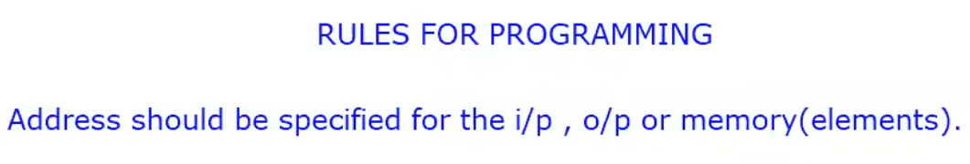
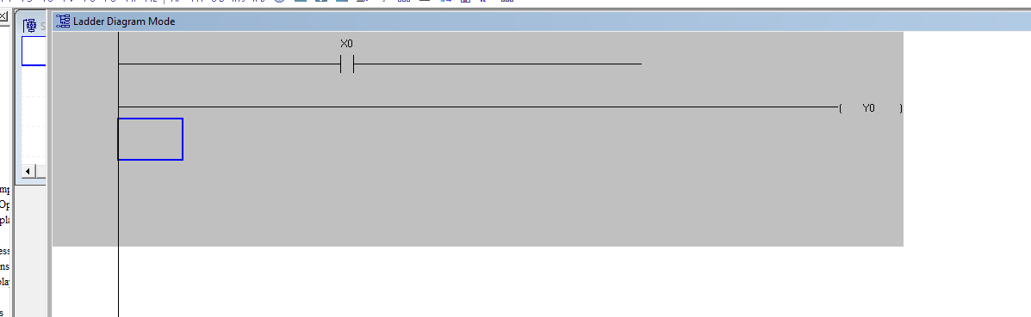
Wrong connections

Slide 2
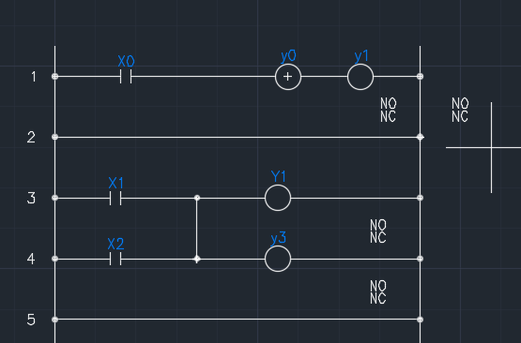
Wrong connections

Slide 3
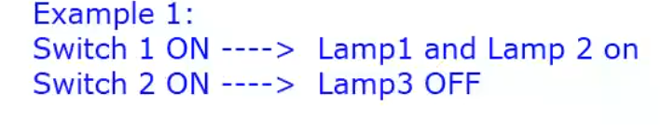

Slide 5
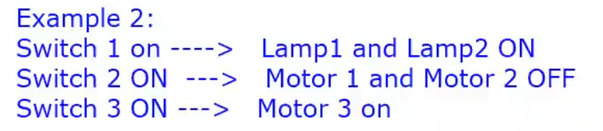

Slide 7
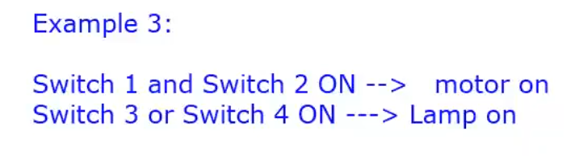

Slide 9
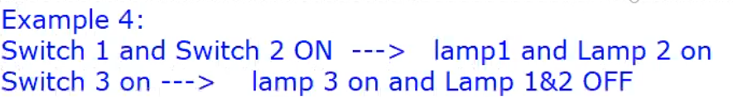

Slide 11
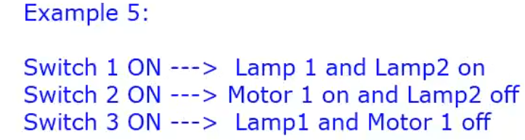

Slide 13
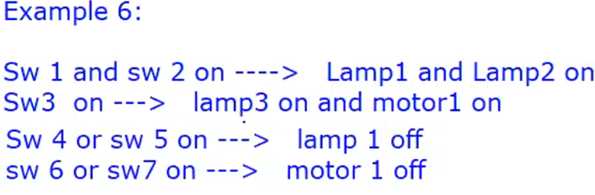

Slide 15
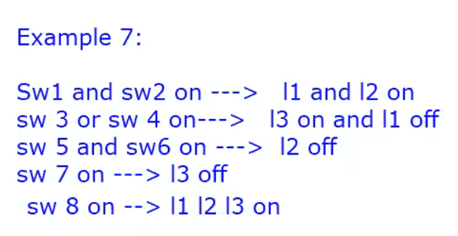

Slide 17
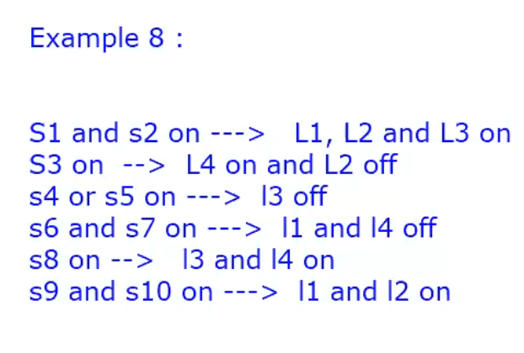

Slide 19
Left and right limit switch exercise

Slide 20
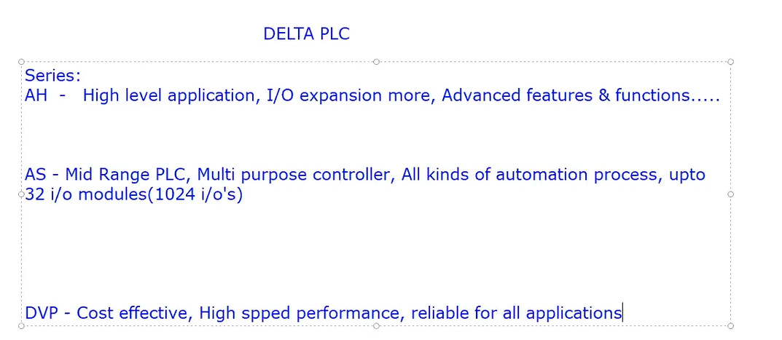
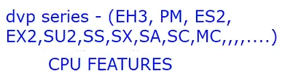

Slide 21
SET AND RESET INSTRUCTION

Slide 22
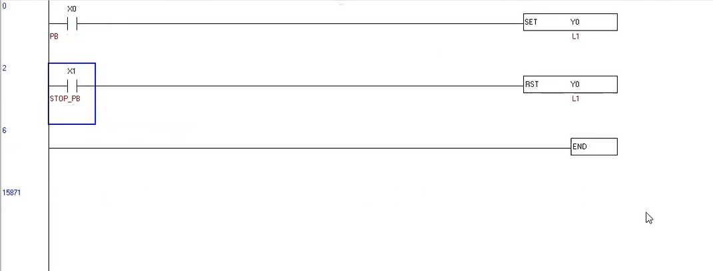

Slide 23
RISING EDGE&FALLING EDGE

Slide 24
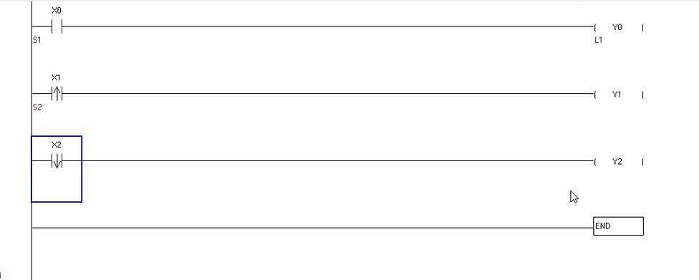
Input side

Slide 25
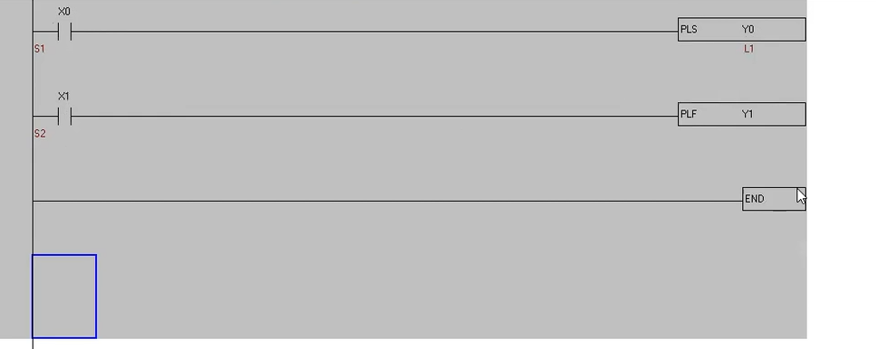
Output side

Slide 26
Master control/Main control

Slide 27
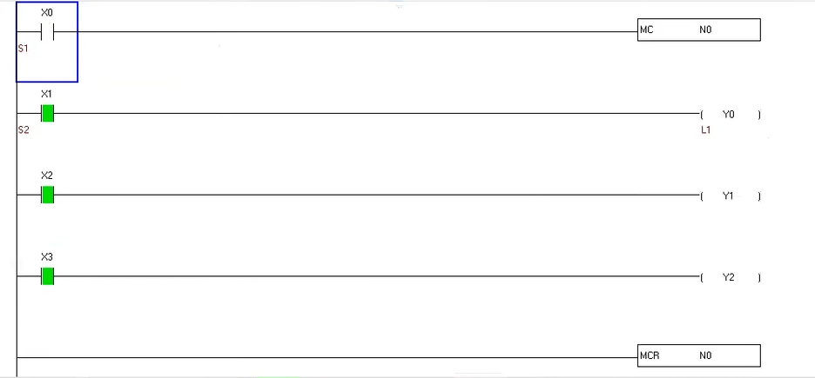

Slide 28
TIMER

Slide 29
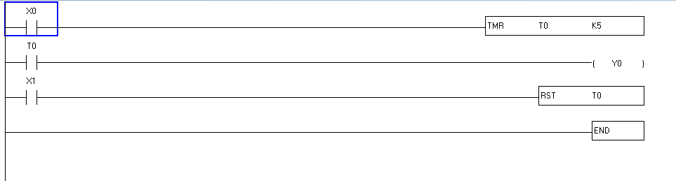

Slide 30
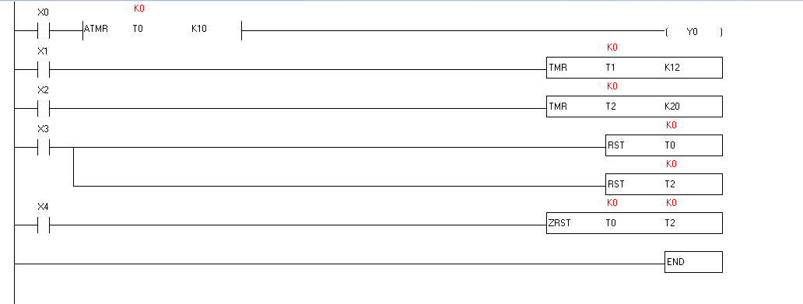
CONTACT TYPE TIMER
ZONE RESET

Slide 31
COUNTER

Slide 32
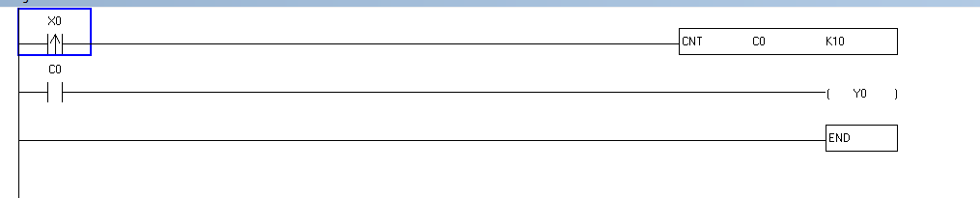

Slide 33
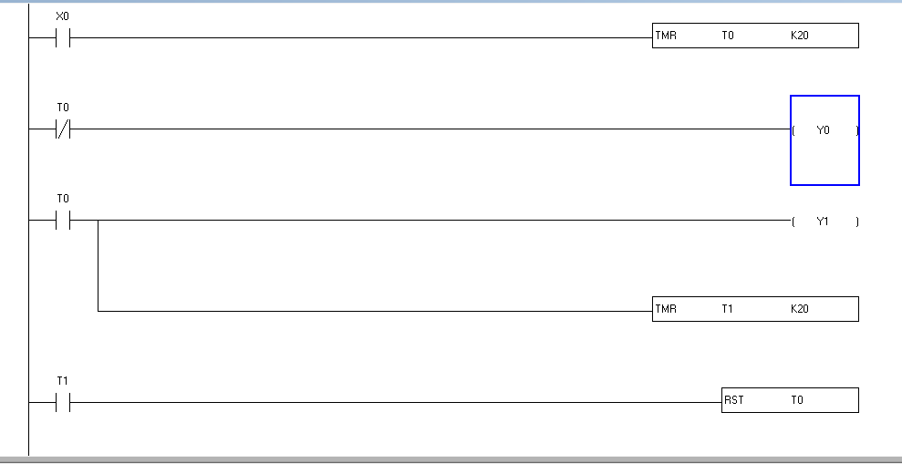
Success task r and f

Slide 34
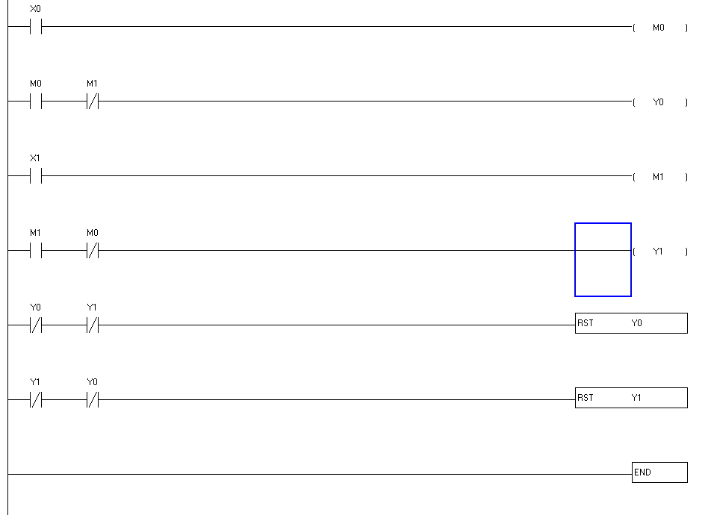
Manual f and r

Slide 35
NP and PN instruction

Slide 36
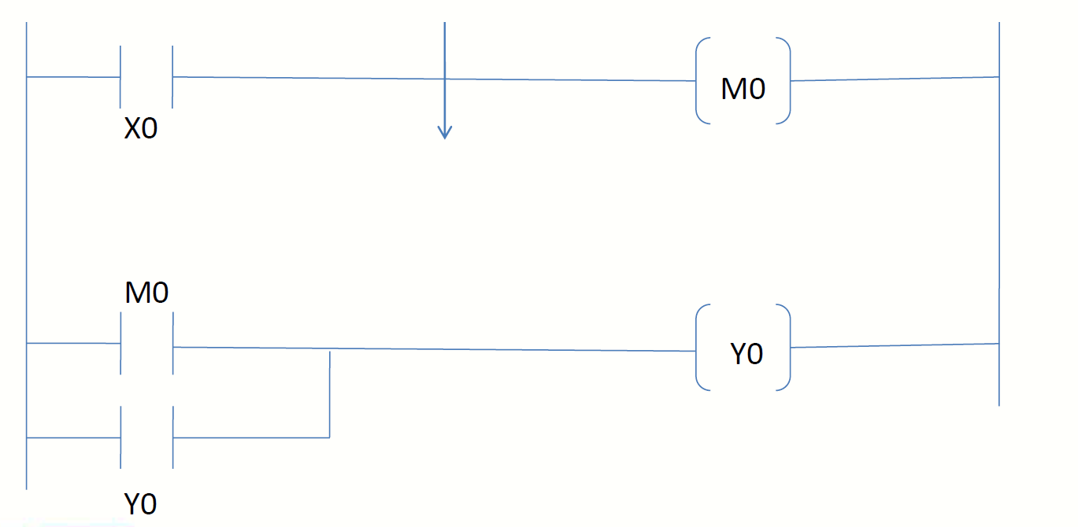
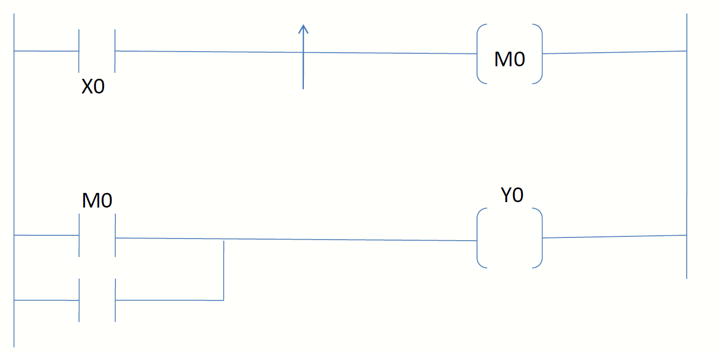
PN
NP

Slide 37
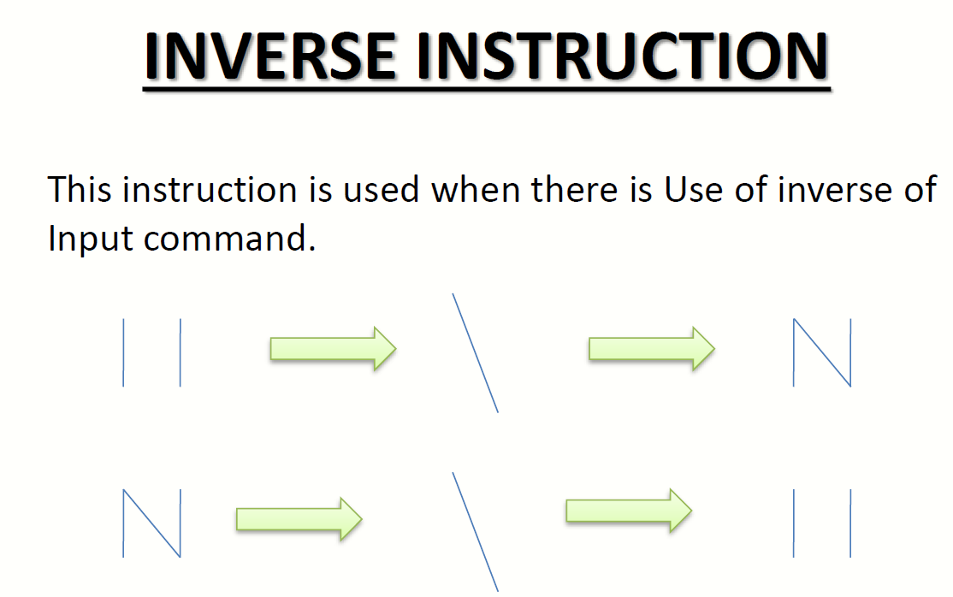

Slide 38
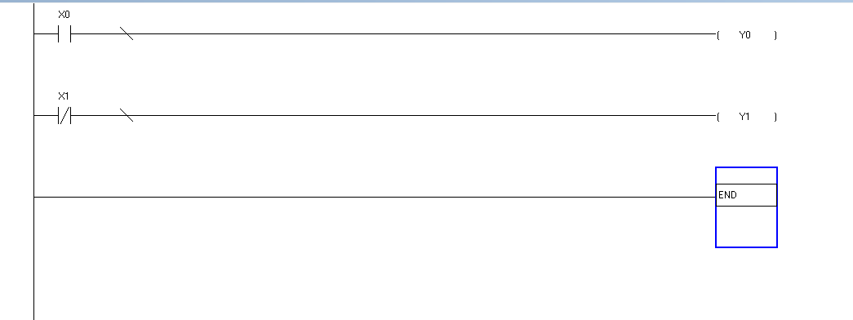

Slide 39
MATHS OPERATION

Slide 40
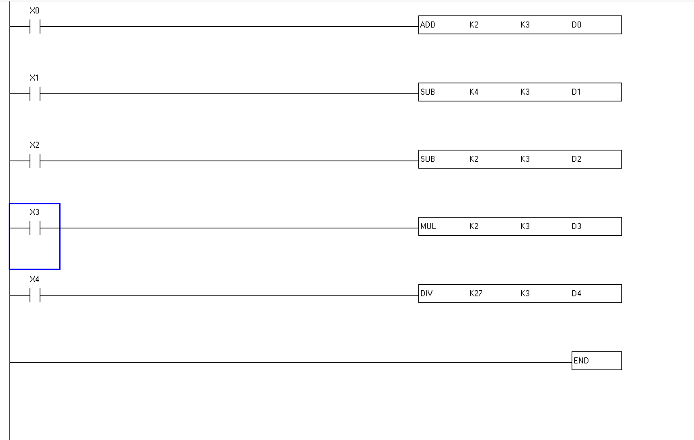

Slide 41
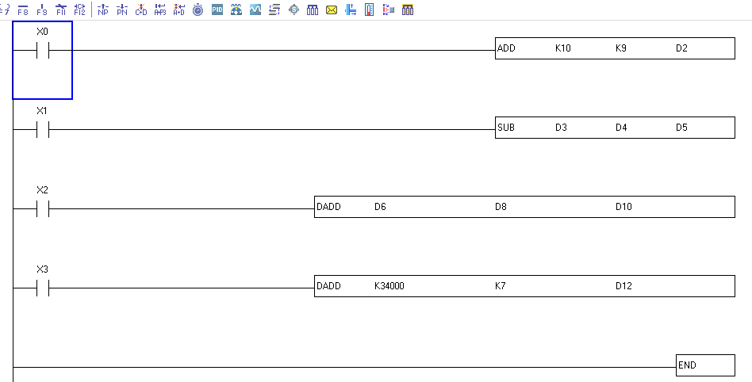

Slide 42
MOVE

Slide 43
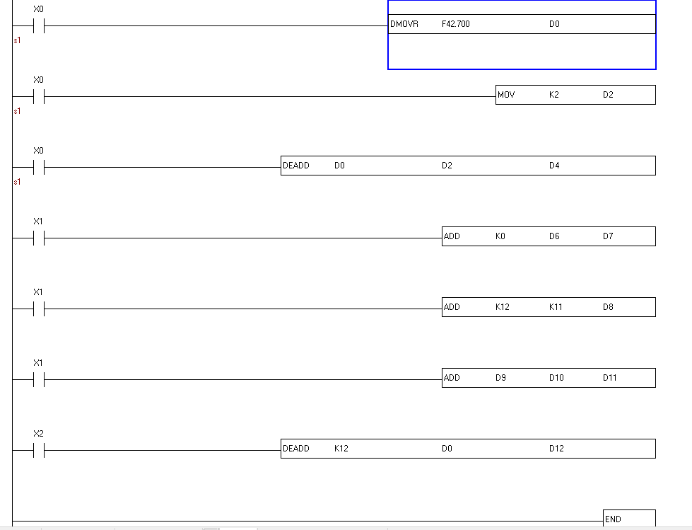

Slide 44
COMPARE

Slide 45
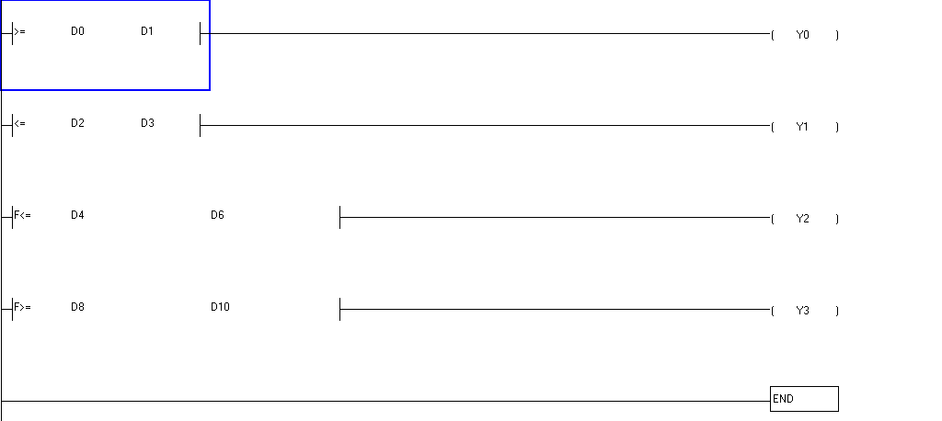

Slide 46
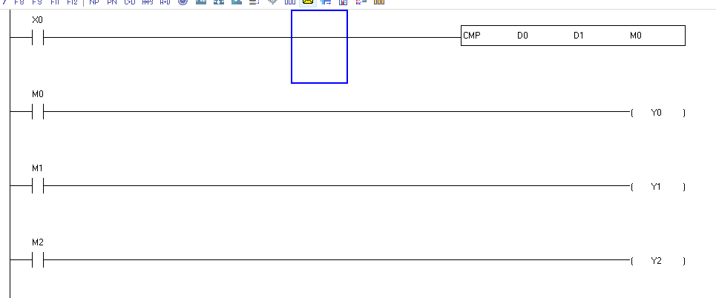

Slide 47
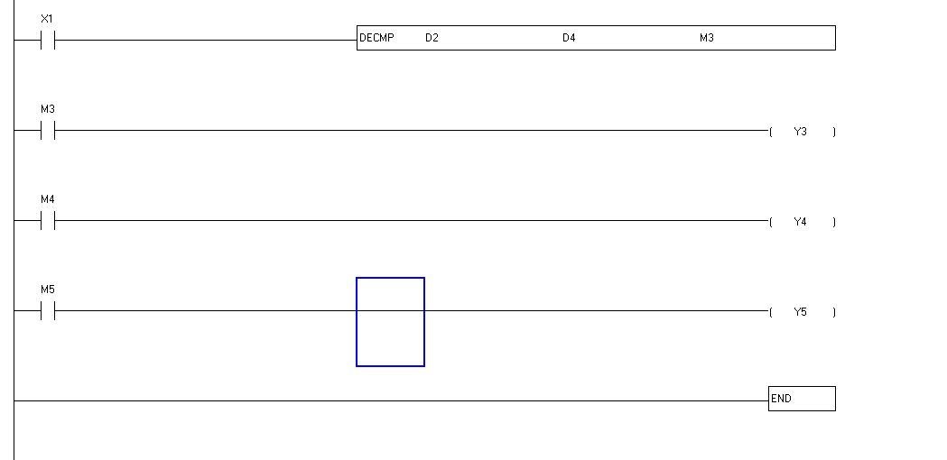

Slide 48
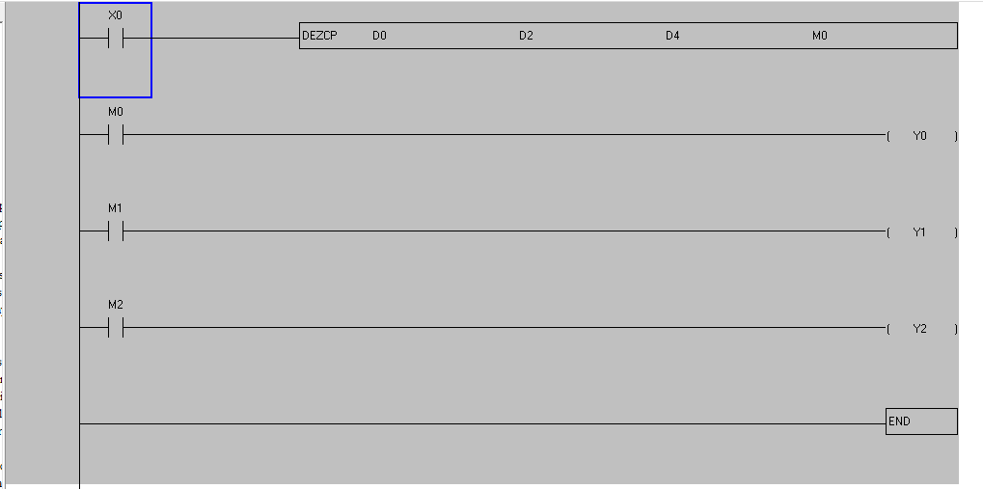

Slide 49
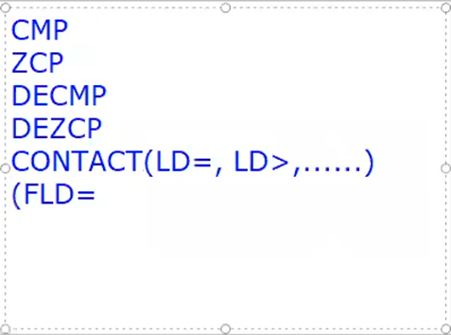

Slide 50
INCREMENT DECREMENT

Slide 51
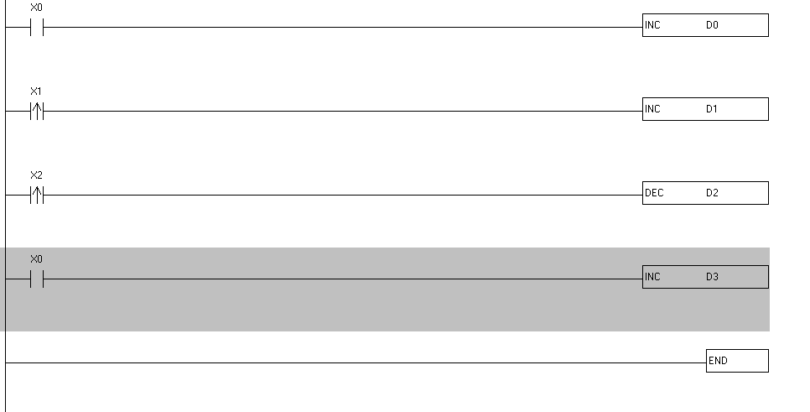

Slide 52
COMPILMENT and SCIENTIFIC CALC

Slide 53
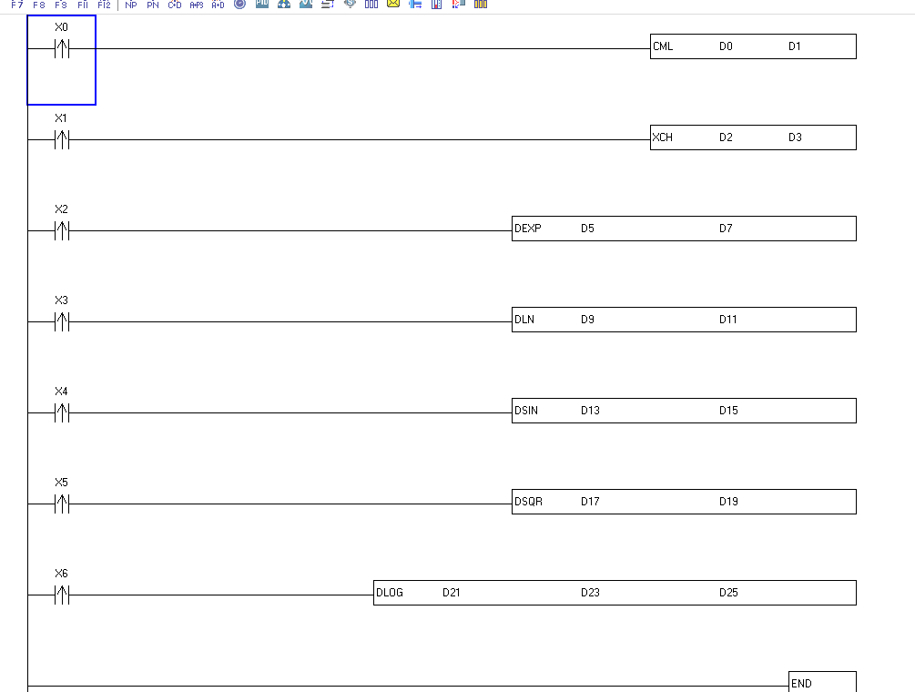

Slide 54
BOOLEAN

Slide 55
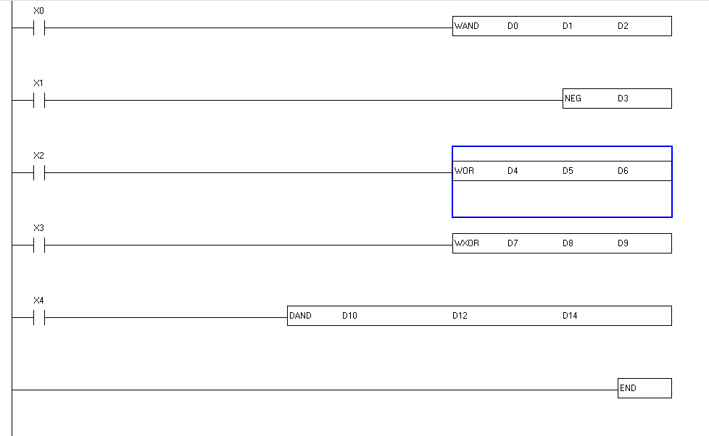

Slide 56
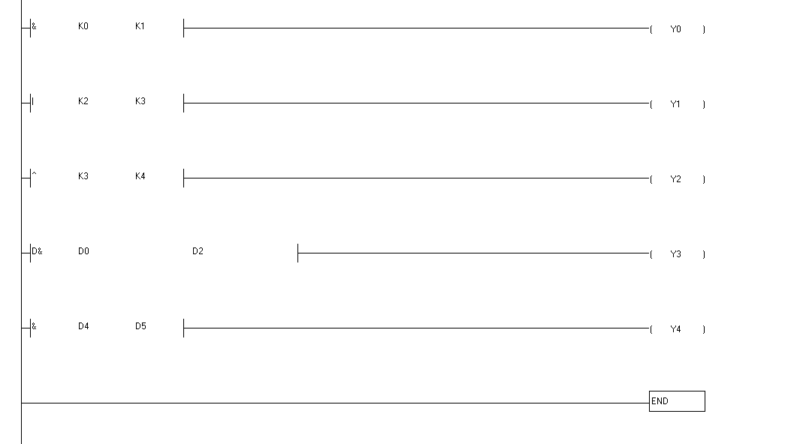
CONTACT TYPE BOOLEAN

Slide 57
BCD BIN

Slide 58
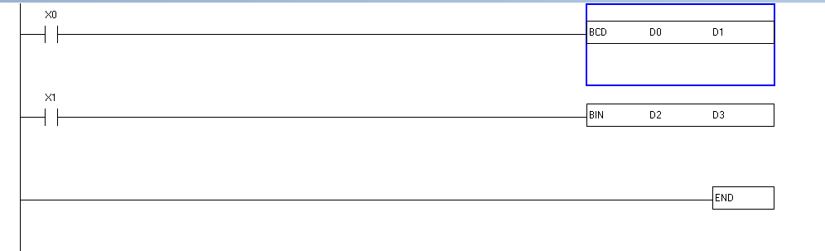

Slide 59
Jump

Slide 60
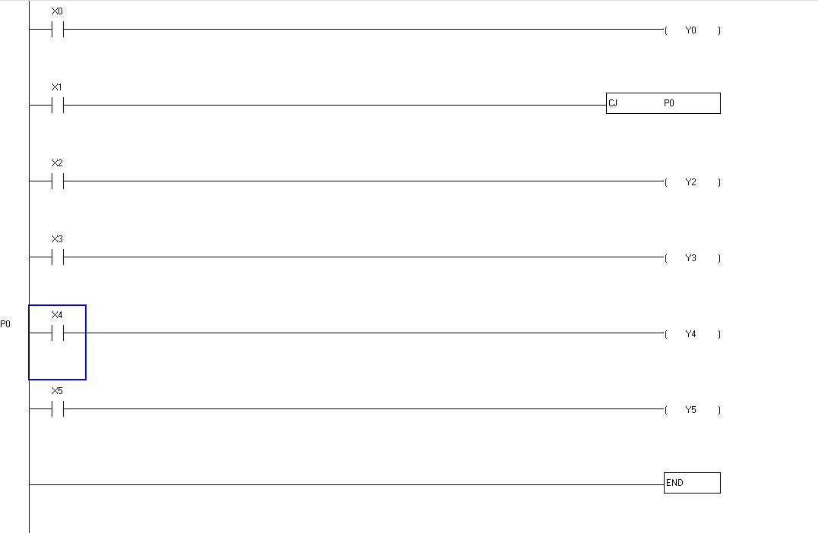

Slide 61
CALL SUBROUTINE

Slide 62
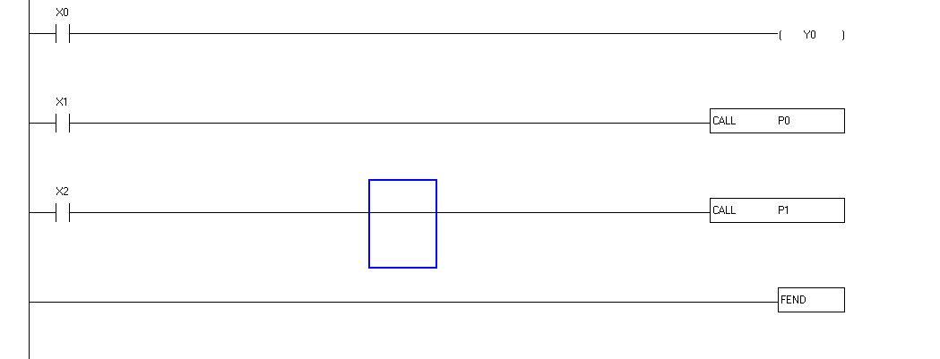

Slide 63
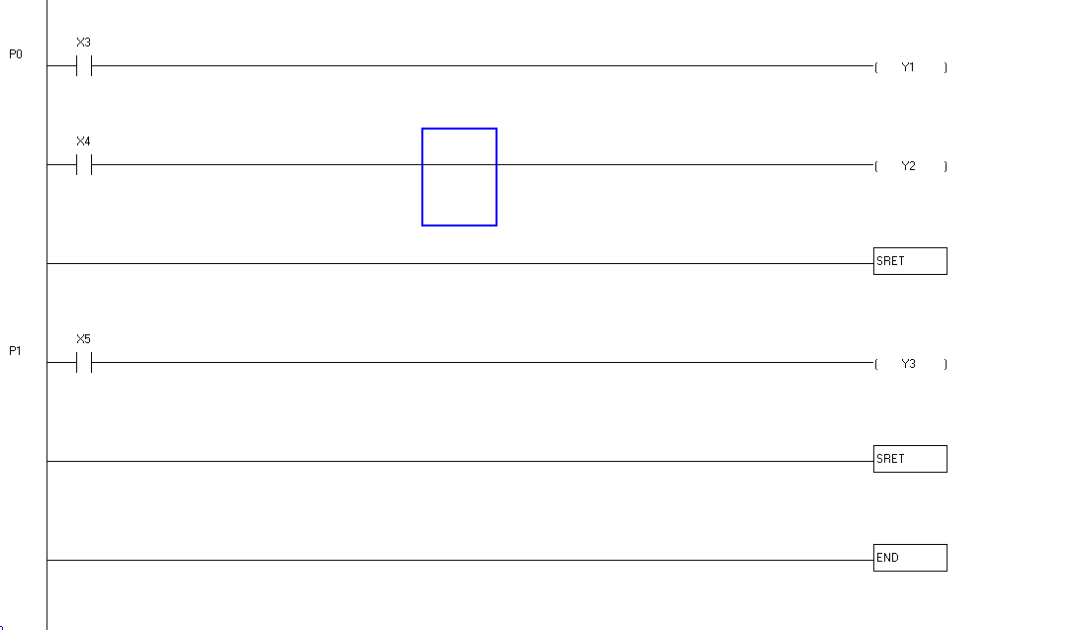

Slide 64
To develop a ladder diagram for the ON/OFF temperature controller for the continuous process of heating of mixture.
Sequence:
On button to start the process when motor start and V1 is open.
Then check the level, is it high level is reached or not.
If a high level is reached turn ON the stirrer & heater at a time.
After mixing & heating turn OFF the stirrer & heater.
Finally, release this mixture through valve V2.

Slide 65
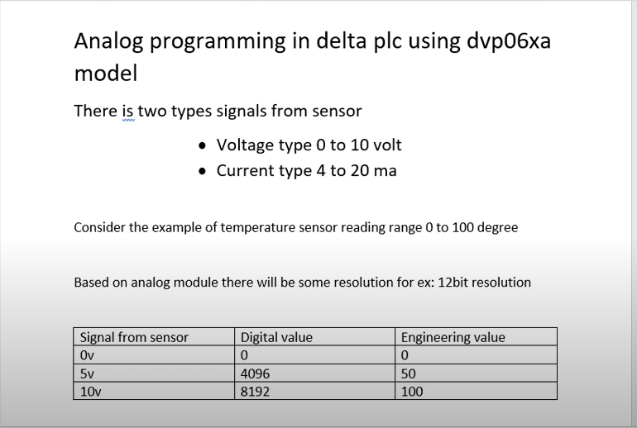

Slide 66
This image explains analog programming for the Delta PLC model **DVP06XA**, focusing on handling analog input signals from sensors. Here’s a breakdown:
1. **Input Signal Types**:
- Voltage (0–10V)
- Current (4–20mA)
2. **Example**:
- For a temperature sensor with a range of 0–100 degrees Celsius.
- The analog module has a **12-bit resolution** (0 to 8192 digital values).
3. **Mapping**:
- **0V** maps to **0 digital value** and **0 degrees**.
- **5V** maps to **4096 digital value** and **50 degrees**.
- **10V** maps to **8192 digital value** and **100 degrees**.
This mapping can be used to program the PLC to convert the raw digital values (from 0 to 8192) into meaningful engineering units like temperature.

Slide 67
For a 4–20 mA current signal, the scaling in the Delta DVP06XA analog module would be similar to the voltage signal but with different base values. Here’s how it typically maps:
1. **Signal Range**:
- 4 mA corresponds to the minimum (0 degrees or 0%).
- 20 mA corresponds to the maximum (100 degrees or 100%).
2. **Digital Values**:
With a 12-bit resolution (0 to 8192):
- **4 mA** maps to around **819** digital units (since 4 mA is about 20% of the range).
- **20 mA** maps to **4096** digital units (the upper end of the 4–20 mA signal range).
3. **Scaling to Engineering Units**:
If we want to map digital values to a temperature range of 0 to 100 degrees:
- Use the formula:
\[
\text{Temperature (°C)} = \frac{\text{Digital Value} - 819}{4096 - 819} \times 100
\]
**Mapping Table**:
| Current Signal | Digital Value | Engineering Value (Temperature °C) |
|----------------|---------------|-------------------------------------|
| 4 mA | 819 | 0 |
| 12 mA | 2458 | 50 |
| 20 mA | 4096 | 100 |
You can use this scaling formula in the PLC to interpret the digital values from the analog input as a temperature in degrees.

Slide 68
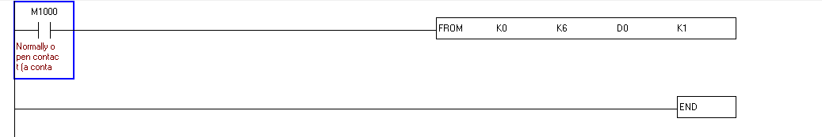

Slide 69
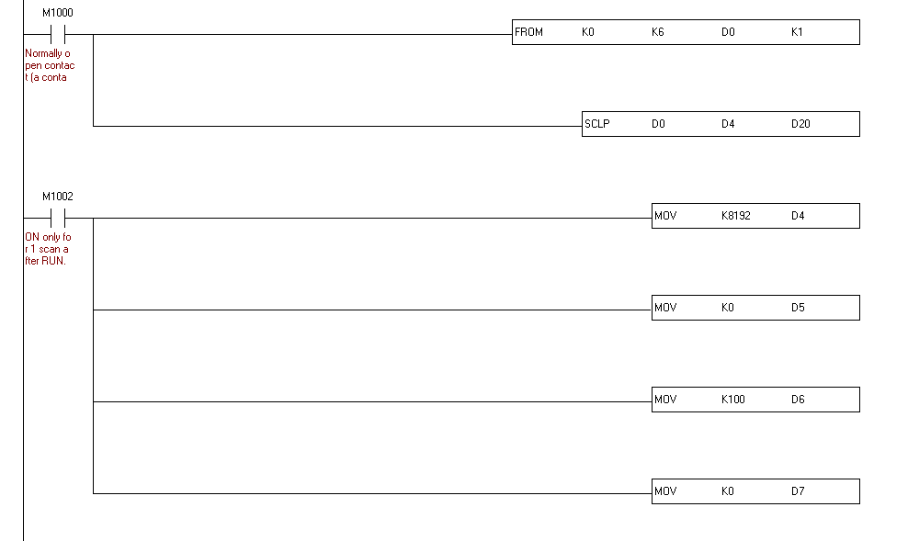
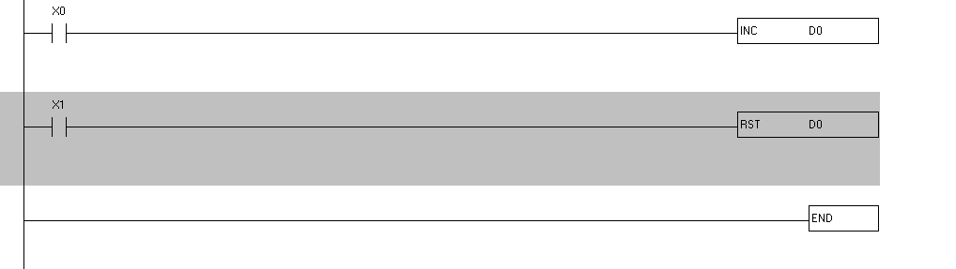

Slide 70
Supervisiory Control And Data Acquisition

Slide 71
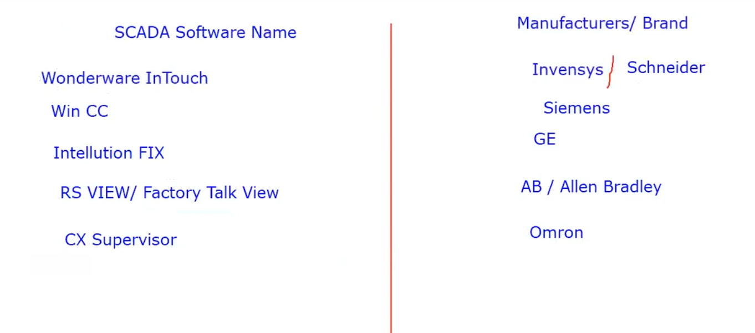

Slide 72
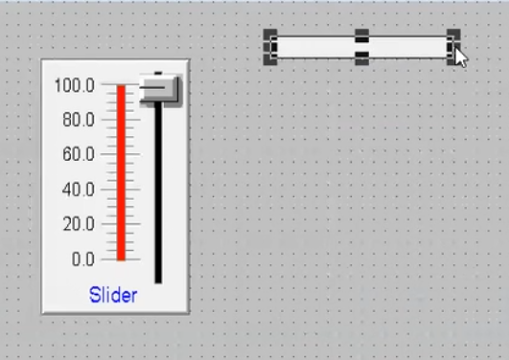

Slide 73
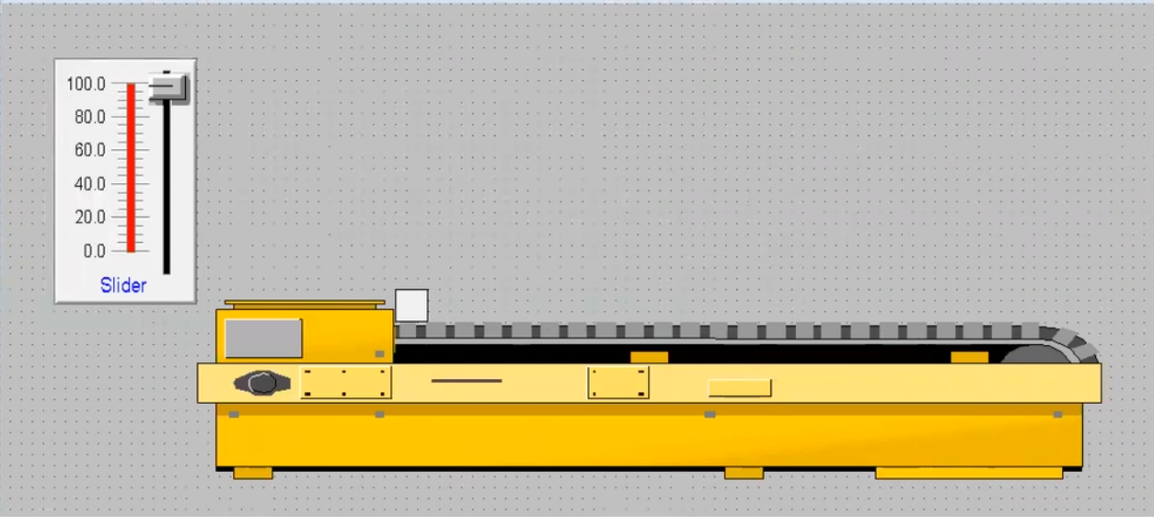

Slide 74
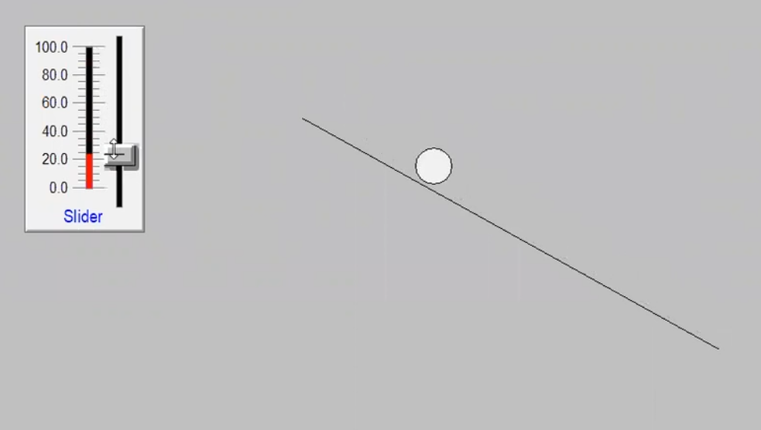

Slide 75


Slide 76


Slide 77


Slide 78


Slide 79


Slide 80

Multiple window

Slide 81

Visibility

Slide 82

exercise

Slide 83

blinking

Slide 84

orientation

Slide 85

Tooltip & Disable

Slide 86


Slide 87


Slide 88


Slide 89


Slide 90


Slide 91

script
Window script

Slide 92



Slide 93


Slide 94



Slide 95



Slide 96


Slide 97


Slide 98

Copy same script in action

Slide 99


Slide 100


Slide 101


Slide 102

Recepie creation

Slide 103


Slide 104


Slide 105


Slide 106


Slide 107


Slide 108


Slide 109

Database using ms access

Slide 110


Slide 111

Rename table into your desire name

Slide 112


Slide 113


Slide 114


Slide 115


Slide 116


Slide 117


Slide 118
Create sw1 and T1 tags

Slide 119


Slide 120


Slide 121


Slide 122


Sql insert take from function->All
Sql insert from help

Slide 123


Slide 124

Data get updated

